Slide 1




ORGANIZATIONAL BEHAVIOR
Module 8
Organizational Design

Slide 2
MODULE 8
ORGANIZATIONAL DESIGN
This is a macro-level issue
  Organization design is a series of decisions made by the managers about the best organizational arrangements to achieve the goals in their strategic plans.

Slide 3
MODULE 8
ORGANIZATIONAL ANATOMY
This is How managers put people together to co-ordinate their work and to achieve the organization’s goals.
  Organization’s structure resolves two basic tasks:
      Dividing up the work in the organization
      Ensuring the work gets done by providing coordination and control of work

Slide 4
MODULE 8
Mechanistic Organization
Burns and Stalker have labeled organizations as either
1- Mechanistic organizations
  High division of labour
  Low delegation of authority
  Departments with great uniformity of work activities
  Narrow spans of control
  Organizations possess tight rules and policies and coordination which is formal and written.

Slide 5
MODULE 8
Organic Organization
2- Organic organizations
  Less job specialization
  Greater delegation
  Low uniformity among employees in work units
  Wide span of control

Slide 6
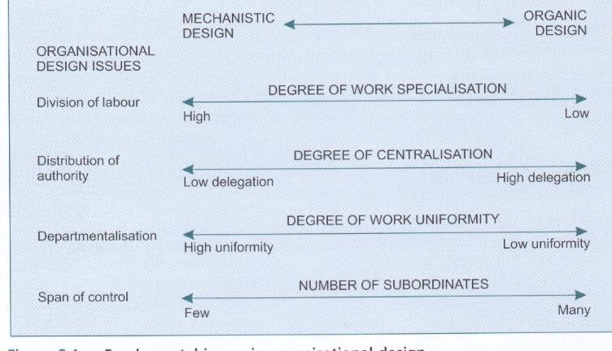

Slide 7
MODULE 8
Organic Organization
2- Organic organizations
  Employees in organic organizations:
  Have few rules and procedures to follow
  Expect face-to-face or informal coordination
  Expect to be empowered to create their own plans and schedule

Slide 8
Organization Structure
The formal pattern on interactions and coordination designed by management to link the tasks of individuals and groups in achieving organizational goals.
Organization chart: A line diagram that depicts the broad outlines of an organization’s structure

Slide 9
Organization Structure
Chain of command: The unbroken line of authority that ultimately links each individual with the top organizational position through a managerial position at each successive layer in between.

Slide 10
MODULE 8
ORGANIZATIONAL DESIGN ASPECTS
DIVISION OF LABOR
2. DISTRIBUTION OF AUTHORITY
3. SPAN OF CONTROL
4. DEPARTMENTALIZATION

Slide 11
MODULE 8
ORGANIZATIONAL DESIGN ISSUES
DIVISION OF LABOR
  It is the degree of job specialization in a firm
  It is the specific tasks and work methods which define an employee’s job.
  Its aspects are:
    Specifying the type of work performed ( research scientist, production manager, computer programmer)
    The work methods or processes to be used (accounting, marketing, production)

Slide 12
MODULE 8
ORGANIZATIONAL DESIGN ISSUES
DIVISION OF LABOR
  is the primary source of increasing productivity as a result of specialization.
  Output per employee increases as more employees performing related tasks are grouped together
  Technological advances in communication and process control overcome coordination problems as work unit size increases. Such advances make it possible for one manager to supervise a large number of employees, even telecommuters.

Slide 13
MODULE 8
ORGANIZATIONAL DESIGN ISSUES
DIVISION OF LABOR
  Division of labour makes companies effective because managers break down jobs into subtasks at which employees develop expertise through repetition.
  Companies capture efficiencies in production systems which can be transformed into lower cost per unit of output and sustainable competitive edge.

Slide 14
MODULE 8
ORGANIZATIONAL DESIGN ISSUES
DISTRIBUTION OF AUTHORITY (Delegation)
Delegation of authority is a manager’s decision about how much authority to give to subordinate.
Authority is a legitimate right to give direct orders to teams or individuals. It flows to a manager from his position in hierarchy or chain of command
Getting more authority can be a powerful motivator (intrinsic reward)

Slide 15
MODULE 8
Principles of delegation of authority
For each responsibility delegated to a team or subordinate, an equal amount of authority must be given.
All decisions should be delegated to the lowest organizational level possible.
Practice management by exception
A manager only becomes involved when an exception to the work routine of the team or subordinate occurs.

Slide 16
MODULE 8
Principles of delegation of authority
DISTRIBUTION OF AUTHORITY (Delegation)
Managers should tell the teams or subordinates not only what to do but how to do it.
The subordinate’s responsibility to his superior is absolute, and superiors cannot escape responsibility for the performance of their subordinates. Managers are responsible for the work of their subordinates.

Slide 17
MODULE 8
ORGANIZATIONAL DESIGN ISSUES
SPAN OF CONTROL
The number of subordinates who report to a given manager.
There is no agreement on the ideal span control
Most experts note that span of control is influenced by the number and intensity of interpersonal relationships

Slide 18
MODULE 8
ORGANIZATIONAL DESIGN ISSUES
SPAN OF CONTROL
There are three factors affect a manager’s span of control:
  Required contact: frequent face to face contact: e.g. medical services & self directed team

Slide 19
MODULE 8
ORGANIZATIONAL DESIGN ISSUES
SPAN OF CONTROL
  Degree of specialization: Modern computer based communication system makes employees performing complicated work from home and stay in instant contact with work colleague by being on line.
  In general, manager lower in the firm can have a wider span if her oversees many specialized employees doing the same thing

Slide 20
MODULE 8
ORGANIZATIONAL DESIGN ISSUES
SPAN OF CONTROL
  Ability to communicate: Managers who can clearly and concisely convey company policies, procedures and work expectations to subordinates can manage a wider span of control.Geographic separation no longer means ineffective communication

Slide 21
Departmentalisation
Departmentalisation refers to how work activities are grouped together.
Functional departmentalisation groups work activities around essential functions such as manufacturing, sales and finance.
Departmentalisation can be based on technology, product, types of customers, types of distribution channels used, or geographic regions.

Slide 22
1- FUNCTIONAL STRUCTURE
Functional Structure: A structure in which positions are grouped according to their main functional (or specialized) area such as: Operations, Finance, Marketing, Human Resources, Sales, R&D, etc

Slide 23
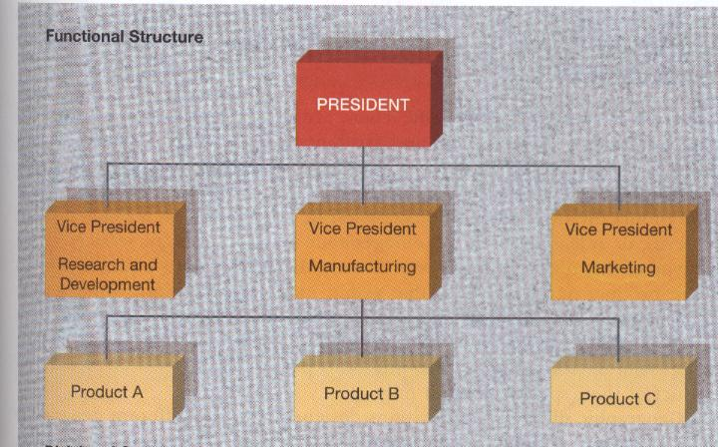

Slide 24
1- FUNCTIONAL STRUCTURE
Advantages
  In-depth development of expertise
  Clear career path within function.
  Efficient use of resources
  Ease of coordination within function
  Potential technical advantage over competitors

Slide 25
Disadvantages of Functional Designs
Over-specialisation take place and narrow the business viewpoints
The development of managers is limited to their areas.
Co-ordination between departments can weaken
Employees identify more with their departments than with the firm.
Managers may fail to develop a strong focus on customers, products or markets

Slide 26
1- FUNCTIONAL STRUCTURE
Uses of functional Structure
  Small and medium size organizations
  Functional structure is suitable for large organizations that operate in a stable environment and when considerable coordination is required among products.

Slide 27
The Territorial Design
The territorial design establishes work groups based on a geographic area.
All activities in a particular area should be controlled by a single manager.
He would control all company activities in a single region.

Slide 28
The Territorial Design
Disadvantages of the territorial form of departmentalisation.
There is a danger of duplication of effort across departments serving various territories or regions.
The company must be able to hire general managers handling several functions such as production, sales and human resources.

Slide 29
Advantages of Product Divisional Design
1- Provides flexibility in meeting customers needs.
2- External changes can be detected more quickly and well understood.
3- Employees gain deep understanding of their products & markets.

Slide 30
Advantages of Product Divisional Design
4- Encourages the development of separate business units (profit centres) competing friendly to maximise profits.
5- Performance measures are easy to create and to judge the performance of various divisions .
6- The design shifts some of the burden for general management to division heads.

Slide 31
Disadvantages of Product Divisional Structure
1- Duplicated effort and resources due to solving similar problems without consulting other divisions.
2- Finding and training people to head each division is a difficult job.
3- Conflicts can arise due to sharing resources when product divisions attempt ‘joint ventures.

Slide 32
Matrix Departmentalisation
Creates the need for the specialised management position called ‘Project Manager’.
PMs are knowledgeable & have responsibilities exceeding their authority for the projects.
The team members have two or more bosses, one project manager and a functional boss.
The matrix design violates the ‘unity of command (one boss for each employee).

Slide 33
Advantages of Matrix Design
1 - The matrix design combines the strengths of the product divisional and functional designs.
2 - The design blends an emphasis on market changes with management and technical expertise in a given product or project areas.
3 - It develops managers with technical product and project knowledge who can communicate effectively with other functional departments.

Slide 34
Advantages of Matrix Design
4 - A self contained department can devote its undivided attention to the needs of its product, project or customers
5 - The firm can focus on specific products and their development without creating permanent units .

Slide 35
Disadvantages of the Matrix Design
1- Confusing design as employees do not know their real boss and leads to game playing & loss of focus in both.
2 - Requires excellent planning and r. allocation to ensure that functional work proceeds .
3 - PMs must have excellent technical, political, communication skills. Extensive training must be given or hire new employees with experience.
4 - May lead to excessive overhead costs.

Slide 36
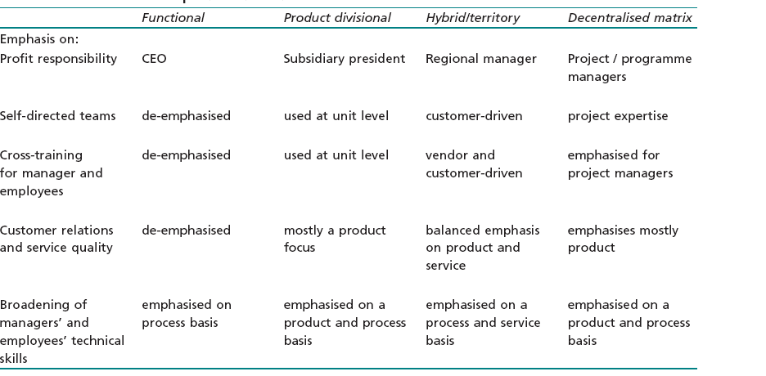
Forms of Departmentalisation

Slide 37
Standardisation
Written work guidelines are formulated so that similar work activities are performed in the same way each time.
Greater standardisation and formalisation lead to greater centralisation and larger administrative ratios in firms.

Slide 38
Conglomerates
A conglomerate is a holding company that acquires many other companies which have entirely different business strategies and operate in diverse industries.
The acquisition of companies could happen in case of:
1) Undervaluation
2) Financially distress
3) Likely to grow but can not because they have limited capital.

Slide 39
Conglomerates
Conglomerates are very large and they have widely different, unrelated product lines and services.
They are managed through a system of autonomous subsidiary presidents who report to sector or group vice presidents who in turn report to the conglomerate’s CEO.

Slide 40
Strategic Alliances
A strategic alliance is a form of inter organisational design.
It is a cooperative agreement between two firms that fall short of a merger or full partnership.
It can involve joint product development or research, production technology sharing, marketing of one another company’s products.
Used for companies in the same industry but based in different countries to compete on a global scale while maintain their independence.

Slide 41
Problems Of Strategic Alliances
Require exhaustive coordination through meetings.
2) What is to be shared and what remains proprietary?
3) Overcoming cultural and language barriers.
4) Rising above suspicion and mistrust.
5) Depending too much on expertise and skills of another company.

Slide 42
Outsourcing
Is a form of strategic alliance that raises company performance by the recognition that a supplier has a competitive advantage that the company cannot easily match.
It is contracting outside firms for goods or services that support manufacturing, purchasing, sales, product development and personnel .

Slide 43
Coordination
Coordination is a set of mechanisms which managers employ to link the actions of organisational subunits to achieve a pattern of consistent outcomes.
The extent of coordination necessary in the organisation is determined by the amount of information to be processed during task accomplishment.
Stable environments require fewer methods for coordinating the work of subunits.

Slide 44
Coordination
Turbulent business environments create more information processing needs than placid environments
As external uncertainty increases, information processing capacity in the firm must increase.

Slide 45
Vertical Versus Horizontal Coordination
Vertical Coordination strengthens the link between organisation levels
Horizontal Coordination mechanisms ensure the orderly processing of the company’s workflow.

Slide 46
Vertical & Horizontal Coordination
Vertical Coordination must decrease uncertainty to be effective.
It can be enhanced by using groups, direct supervision, standardised work processes, standardisation of outputs, use of performance appraisal, and management information system.
• Horizontal Coordination
can be facilitated by the use of direct manager contact, liaison roles, horizontal task forces, and permanent teams to manage work problems.

Slide 47
Vertical Coordination
1- Use teams and task forces.
To increase coordination and create more group decision making
A collateral organisation is composed of task forces.
It is a parallel, coexisting arrangement of task forces which supplements the formal organisational hierarchy.
The collateral organisation works on problems which cut across the firm and is much broader than a single, temporary task force.

Slide 48
Vertical Coordination
2- Use direct supervision.
This costly form of traditional vertical coordination works through the chain of command.
Supervisors and managers coordinate the work of their subordinates by using standardised work rules and procedures.
This method has fallen out of favour .

Slide 49
Vertical Coordination
3- Use standardisation of work processes.
Much work is so routine that the firm’s technology dictates the pattern of coordination. Little direct supervision is necessary.
Workers do not have to interact with each other.
This method has fallen out of favour because standardisation makes it harder for organisations to utilise self-directed teams.

Slide 50
Vertical Coordination
4 - Use standardisation of outputs.
When direct supervision is minimal and work processes are not standardised, coordination can be achieved by specifying the nature of work outputs.
Coordination issues shift from how work is done to ensure that outputs conform to certain physical and economic standards.

Slide 51
Vertical Coordination
5- Use performance appraisal.
Performance appraisal is a tool not often recognised as a vertical coordination .
It can be used to control individual performance and to communicate work goals to employees. Assessments are then communicated upward by managers.
This process links levels of the hierarchy. The newest performance appraisal is the 360 degree system.

Slide 52
Vertical Coordination
6 - Create a management information system.
Management information systems (MIS) are simple devices such as employee suggestion systems or company newsletters.
They consist of computerised information and record keeping systems

Slide 53
Vertical Coordination
Their uses include:
1) Providing early warning signals (product breakthroughs)
2) Providing information to assist decision making
3) Conducting programmed decision making (allocating funds to spread risk in a company’s investment portfolio)
4) Automating routine functions .

Slide 54
Horizontal Coordination Mechanisms
    Use direct contact
    Use Liaison roles
    Use cross functional teams
    Use permanent teams

Slide 55
Horizontal Coordination
The use of direct contact
is a function of the amount of interdepartmental work experience of managers.
Managers with considerable interdepartmental work experience build a network of dependable interpersonal contacts over time.
These contacts facilitate lateral relations which are instrumental in solving workflow problems.
Second, direct contact and lateral relations decay over time because managers are promoted, transferred or dismissed .
The decay in lateral relations must be offset by a programme designed to develop new managers with the task expertise and interpersonal skills .

Slide 56
Horizontal Coordination
2 - Use liaison roles:
The liaison role is formally established to link two or more subunits which must coordinate workflow.
The creation of liaison roles assumes that there are knowledgeable managers in the functional units which need improved horizontal coordination.
The ‘boundary spanning’ managers need excellent political skills and the ability to speak multiple functional languages’.
As the firm becomes more complex and it adds new horizontal departments or divisions, the need for skilful liaison managers
grows.

Slide 57
Horizontal Coordination
3- Use cross functional teams.
To create a temporary task force to provide horizontal coordination.
When problems arise involving numerous departments, a cross functional team can be created with members from the affected departments.
Once the problem is solved, the representatives on the task force return to their functional assignments.

Slide 58
Horizontal Coordination
4 - Use permanent teams to manage recurring workflow problems
Creating permanent teams to address problems.
Large corporations use product and brand managers to preserve the profitability of their extensive product lines.

Slide 59
Spans of Control
Narrow spans may frustrate professionally trained and experienced employees who believe they should have autonomy at work.

Slide 60
Control in Organisations
Organisational control is set of mechanisms used to keep action and outcomes within predetermined limits.
Process control is the standardisation of task performance.
It can be achieved by specifying work methods and setting work standards.
Process control can limit organisational flexibility if the firm operates in a turbulent environment.
It can be external or internal.

Slide 61
Factors Disturbing External Business Environments
Knowledgeable repeated buyers who compare prices and product options
2) Much shorter product lifecycles
3) Rapid product innovation
4) Production process Improvements
5) Global competition
6) Industry and market deregulation
7) Return hungry investors.

Slide 62
Process Control
External process control refers to organisational units that detect production process problems and correct them.
Internal process control is based in self-directed teams that solve product or production problems with total quality management TQM.

Slide 63
Internal Process Control
Effective internal process control applied by self directed teams creates a number of benefits include
  The creation of meaningful work standards
  Accurate and continuous measurement of performance, specification of employee training and development needs
  A clear team basis for distributing performance or merit based rewards
  A way to link employees and customers,
  A sound basis for taking corrective action.

Slide 64
Results-Oriented Control
Results-oriented control is a system which achieves control by specifying the results to be obtained by employees and their work units.
The most common form of results-oriented control is management by objectives (MBO).

Slide 65
Management By Objectives
MBO rests on superior–subordinate
teamwork to:
1) Establish goals
2) Review goal progress
3) Resolve conflicts and take corrective action with respect to set goals.

Slide 66
Management By Objectives
MBO capitalises on the important motivational force of specifying outcomes to be obtained.
MBO can create problems in organisations if the process of documenting and recording goals becomes more important than the goals themselves.

Slide 67
Success Factors of MBO system
1- Knowledge of what is expected. MBO can reduce misunderstandings for superiors and subordinates. That leads to common work expectations for employees and their managers.
2 - Knowledge of results. MBO systems place a high priority on performance feedback. For the feedback to be effective, it must be supportive and immediate.
3 - The function of the superior. Superiors must work to provide feedback which is work oriented and not personality oriented.

Slide 68
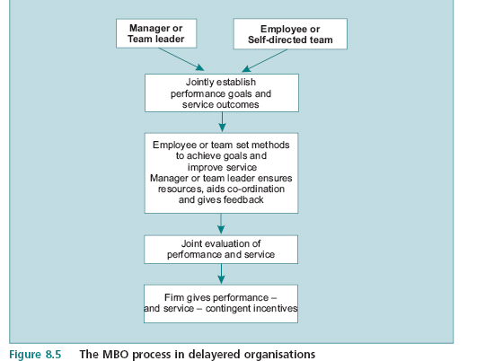
The MBO Process in Delayered Organisations

Slide 69
The Characteristics of a
Typical MBO System
1- Members of unit establish goals and action plans for achieving goals.
2 - Discussion of work unit goals ensures that everybody understands them.
3 - Employees in the work unit establish their own action plans for achieving
their goals. The managers participate in one to one meetings with employees.
4 - The superior and subordinate jointly establish performance measures.
5 - The superior conducts periodic formal and informal feedback with employees concerning individual and work unit goals.
6 - The system is documented with all goals set down on paper.
7- Goals are ‘cascaded’ down the hierarchy.
They become more specific and quantified at lower levels.
Note the emphasis on employee involvement and participation.

Slide 70
Problems in using MBO
1- Employees can develop tunnel vision about results and not give
attention to how task activities .
MBO can be more effective if it is linked to product and service quality .
2- MBO degenerates into a paper work, emphasising completing forms.
3- Superiors fall into an ‘either punish or reward’ mentality regarding results achieved by subordinates.
4 - The collaborative aspects of the system are lost if employees have many goals or are worried about accomplishing their specific goals

Slide 71
The Responsive Organisation
Companies must be designed to respond to:
  New aggressive global competitors
  New products & new technologies
  Price sensitive customers
Responsive firms are designed to respond to
  New competitors, products and technologiers
  De-regulated industries and foreign markets
  Shrewd and price-sensitive customers
  Tough global competitors.

Slide 72
The Responsive Organisation
Responsive firms are customer-oriented and delayered where co-ordination is achieved through technology-based communications.
The primary emphasis is on revenue growth within a reasonable cost structure.

Slide 73
Delayering
Companies reduce the complexity of their structures to reduce costs and to speed decision making process.
The process has 3 steps:
Eliminating several layers of the chain of command
2) Widening the spans of control of managers who remain
3) Reducing the amount of attention paid to employees by managers (elimination of close supervision).

Slide 74
Reassign Supporting Staff
WalMart Corporation, with sales of $190bn has 450 corporate staff employees at its company headquarters while it employs 358 000 people worldwide.

Slide 75
Widen Spans of Control
In responsive firms, spans of control could reach up to 100–200 employees per manager .
Wide spans are made by computer networks which deliver production information to teams of employees that monitor productivity and take corrective measures .
Managers’ jobs shift from control to facilitating coordination.

Slide 76
Workforce Empowerment
Employees can take decisions and have responsibilities.
Responsibilities cover transactions with customers, suppliers, vendors and regulators.
Empowered field reps and specialists have the authority to answer questions and to commit their company to make the necessary adjustments.

Slide 77
Create Team Based
Work System
Responsive Companies rely more on self managed teams to raise productivity, product and service quality and cost effectiveness.
By using teams,firm boost their responsiveness without adding layers to their hierarchies.
Empowered work teams manage themselves and make decisions without close management supervision.

Slide 78
Empowered Teams Decisions
1- Recruiting, hiring, performance evaluation, and termination.
2- Formulating and tracking a budget prepared by the team.
3 - Handling quality control and problem solving.
4 - Developing standards for productivity and quality.
5 - Suggesting new products development .
6 - Work with other teams .

Slide 79
The Boundaryless Organisation
Rigid, hierarchy based firms create several vertical boundaries which act as obstacles to rapid and responsive decision making.
Firms replace complex vertical hierarchies with loose horizontal networks to link traditional functions with cross functional teams.
The boundaryless organisation has more flexible or no vertical and horizontal boundaries by using
  Self directed teams
  Technologically sophisticated communications
  Responsiveness to customers
  Outsourcing and strategic alliances.

Slide 80
The Boundaryless Organisation
Companies expand their responsiveness by forming strategic alliances with suppliers (outsourcing) and competitors.
Outsourcing of sales work to telemarketing firms reduces the costs of goods sold.
Boundaryless firms use lean corporate staffs, wide management spans and empowered, self-directed teams.

Slide 81
The Boundaryless Organisation
The authority boundary is the natural distinction between leaders and followers in firms.
In firms using self managed teams the authority boundary still exists.
To achieve responsiveness, the flat, or delayered firm must move away from issuing orders.
Managers must learn to lead while remaining open to criticism and accepting advice from employees who are experts on various aspects of problems .

Slide 82
The Boundaryless Organisation & The Identity Boundary
The identity boundary consists of employees’ shared experiences and beliefs which set them apart from the rest of the company.
When this boundary is well developed, members of departments and work groups have an ‘us versus them’ attitude.
It encourages employees to trust insiders more than outsiders and undermines cross functional team work and network creation.
Firms excel at socialising new members to get them to identify with the company and its goals.
They only cause coordination and integration problems if adaptability and responsiveness to customers is not a core mission.

Slide 83
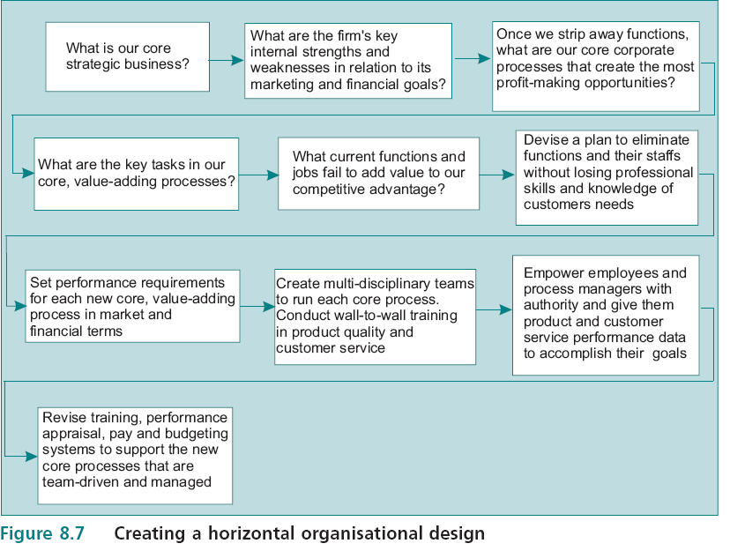
Creating a Horizontal Organisational Design

Slide 84
The Responsive Organisation
The responsive firm emphasise employee training and reward system design.
The customer service spectrum shows a firm the relationships among its types of service and the extent to which employees need more service training.
The spectrum is used by firms to enhance its advantage through service quality improvement.

Slide 85
The Responsive Organisation
Manufacturing assumptions originate in scientific management.
It allows the firm to manage and control the rate of flow of factors of production through its transformation process.
The major and less manageable source of external uncertainty is customer demand for service.

Slide 86
The Responsive Organisation
Firms must abandon the management assumptions that originate in scientific management.
Job designs in the responsive, service-driven firm require employees to recognise sales opportunities as they complete a customised service transaction.

Slide 87
The Responsive Organisation
A customised service requires that employees have the authority and training to systems that are based on:
1- Measurements of customer satisfaction
2- Response times
3- Cost effectiveness in service delivery.

Slide 88
The Responsive Organisation
Service employee empowerment must be at the centre of firms to give front-line service employees the authority and training to deliver high quality service.

Slide 89
Selecting the Best Design
Key design decisions are division of labour, delegation of authority, departmentalisation, and span of control.
The emergent designs for highly competitive firms are delayered, technologically sophisticated and highly customer oriented.
The breakdown of boundaries among units in the firm and between the firm and its customers is driven by the search for competitive advantage .
Depending on environmental turbulence and uncertainty, managers will take decisions to remove boundaries and to delayer.

Slide 90
Customer Service
Companies turn to service improvement to increase profits and market share.
Differentiating service is often easier and faster than differentiating products .
Service improvements strengthen brand loyalty & bad service quickly drives off customers and lowers or erases profits.
The goal in customer service is called the one stop programme, it tries to eliminate the need for transferring customers to different people in the company.

Slide 91
Service Management versus Products
1- Not until service is demanded is it produced.
2- Service is often provided by employees not under the direct supervision of a manager.
3- Services are provided when and where the customer desires.
4-Services are labour intensive.
5- Service is intangible and its characteristics are more difficult to measure than the features of a product .
6- Service is produced in the presence of the customer.

Slide 92
Drivers of Growth in Customer Service
Customers demand better quality.
Service improvements strengthen brand loyalty.
Bad service quickly drives off customers and lowers or erases profits.

Slide 93
Service Improvement
There are three factors to achieve competitive advantage through service improvement
1- A well conceived strategy for service.
In the responsive firm, this is a guiding service concept (business value in the firm’s mission statement) that prompts all frontline employees to discover the customers’ real priorities.
2- Customer oriented frontline people.
The managers encouraged and helped the people who deliver the service to keep their attention fastened on the needs of the customer. This leads to a creative service customisation by employees that marks the service as superior in the customer’s mind.

Slide 94
Service Improvement
3- Customer friendly systems.
The delivery system that backs up the service people is designed for convenience of customers rather than the convenience of the firm and its staff including the physical facilities, policies, methods, and communication processes .

Slide 95
Organising Principles of Service Quality
1) Classifying the firm’s services on the client customer service spectrum
A company must tailor services and ensure that employees have the proper skills to deliver them
2) Organising to improve service subordinate all control processes to service enhancement and adopt employee empowerment.
Putting service first makes a firm emphasise the importance of expanding market share.
Service training of employees 2) Delayering
3) Redesign of information systems to measure customer satisfaction
4) Enhanced incentive systems tomotivate sales to repeat customers.

Slide 96
Service Quality Improvement
3- Using employee empowerment to give frontline, the authority to make on the spot decisions to meet customer’ requests
4- Abandon manufacturing assumptions in service quality delivery.

Slide 97
Creating a Service-Driven Organisation
Step 1: Conduct a service audit.
Audits mean measurement and measurement means tracking customer satisfaction.
The features of service that are important to customers and how they are prioritised is the starting point to design a customer service audit.

Slide 98
Creating a Service-Driven Organisation
Step 2: Develop a companywide service strategy.
  A firm needs a ‘service mission statement’ clarifying how its competitive advantage is based on service quality delivery.
  The Service mission statement should answer the question: ‘Why should customers choose us?’ All aspects of the company’s culture should reinforce the answer to that question.
  A firm’s hiring and training programmes should have as their central focus the creation of a workforce that knows how to deliver the service that keeps customers coming back for more

Slide 99
Creating a Service-Driven Organisation
Step 3: Conduct ‘wall to wall’ employee training.
Training employees to deliver excellent service is an investment in future earnings.
There is a strong link among customer satisfaction, employee morale and service quality training.
Step 4: Implement the service improvement programme.

Slide 100
Creating a Service-Driven Organisation
Step 5: Make the service improvements permanent.
Management practices as performance measurement, incentive system design and communication practices must be changed.
Learning new service focused job behaviours, employees must be rewarded through valued rewards that are tied to service.
The firm can create new values in its culture that centre on service quality.

Slide 101
Success Indicatiors of Service Quality Improvement Program
1- All Employees understand behaviours which lead to excellent service.
2 - New employees are trained in service quality
3 - Measurement of service quality reaches all aspects of company operations.
4 - The company commits to ‘wall to wall’ service training.
5 - Pay is based on measured service excellence.
6 - Recruiting systems reflect the importance of personal attributes that are related to excellent service skills.
7 - Senior employees show the importance of service quality to new workers.
8 - Rivals take notice of the company’s service improvement and copy it.

